Slide 1
Correlation between Bz and AE
Notes: Inverse Patterns, When AE has peak Bz has valley, when AE experiences steady or abrupt increases Bz will experience a steady or abrupt decrease and vise-versa. Better seen in graphs when AE has values BELOW 800.

Slide 2
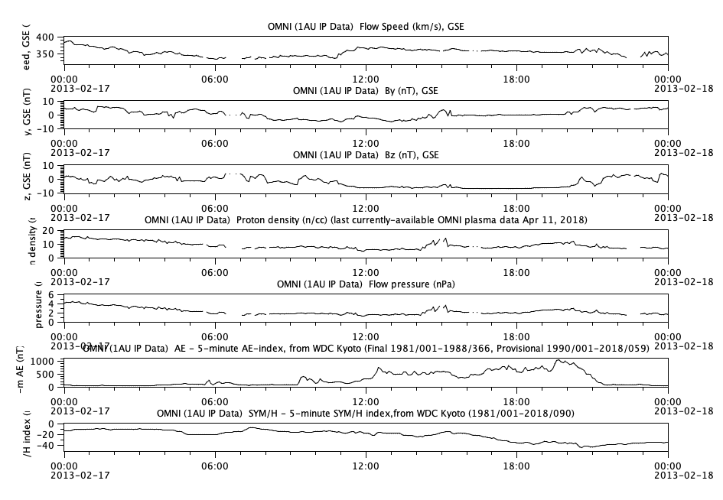
AE > 800

Slide 3
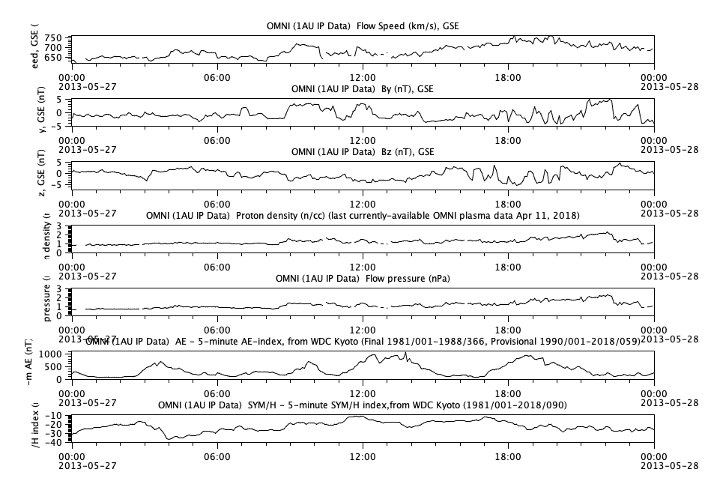

Slide 4
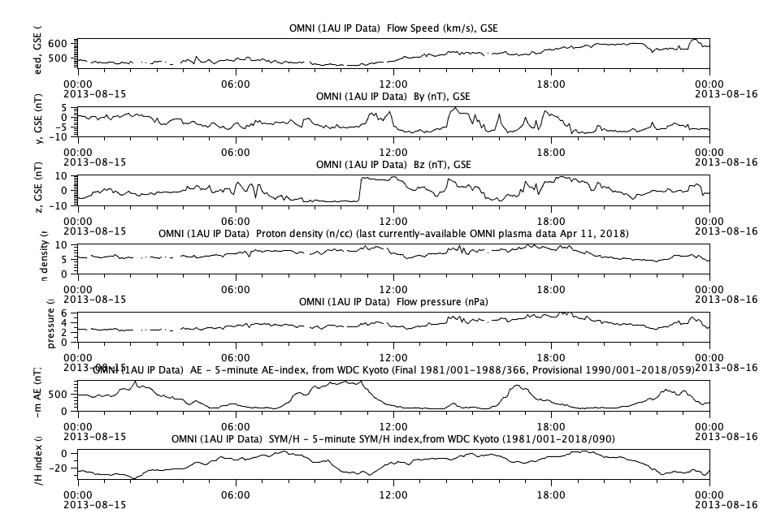

Slide 5
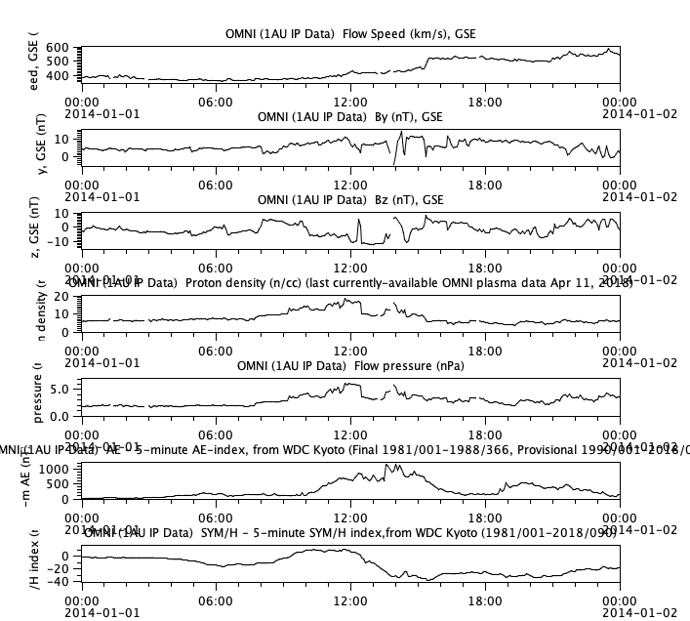

Slide 6
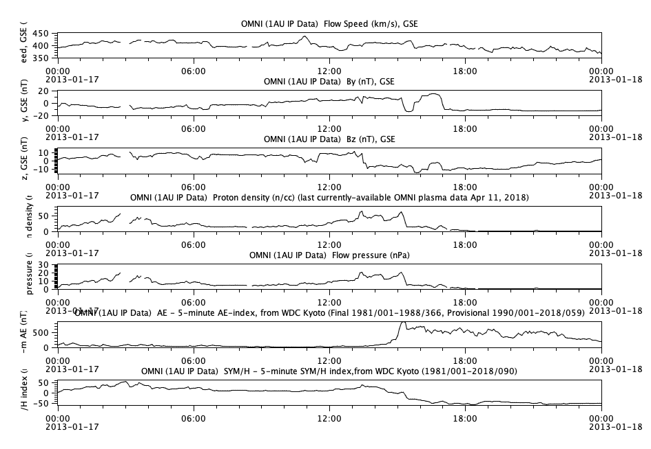
AE < 800

Slide 7
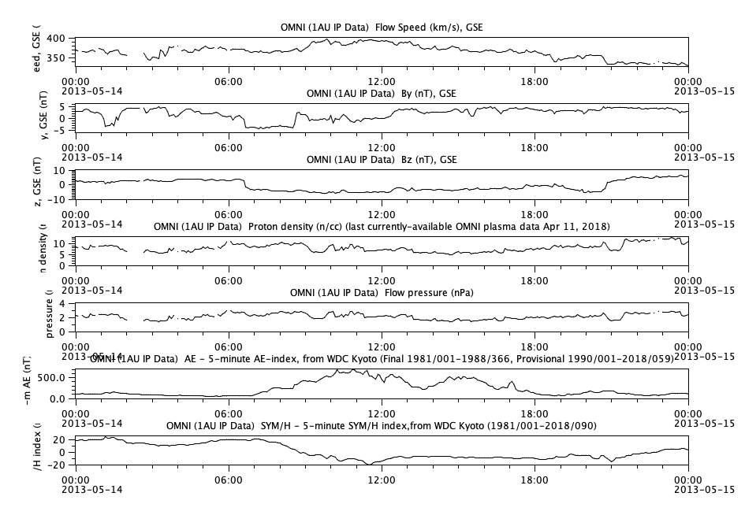

Slide 8
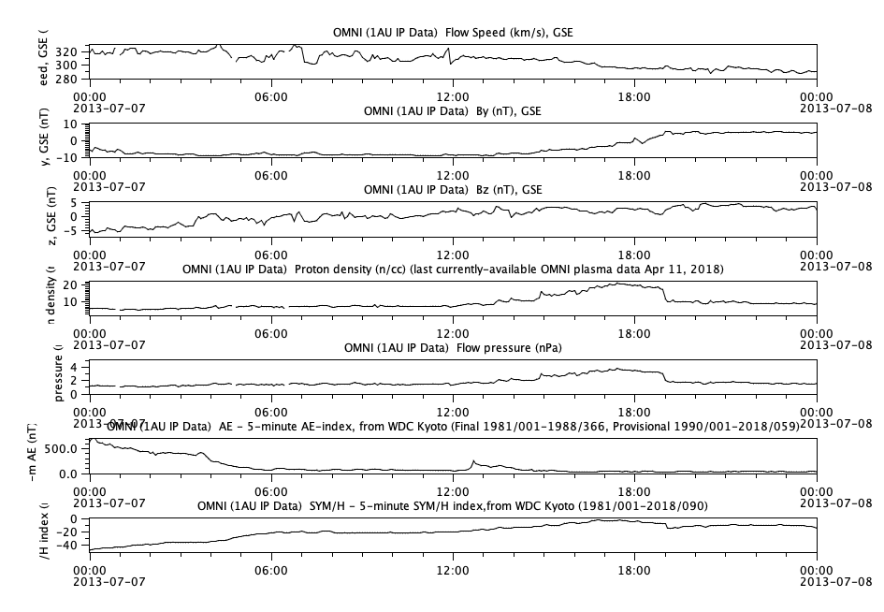

Slide 9
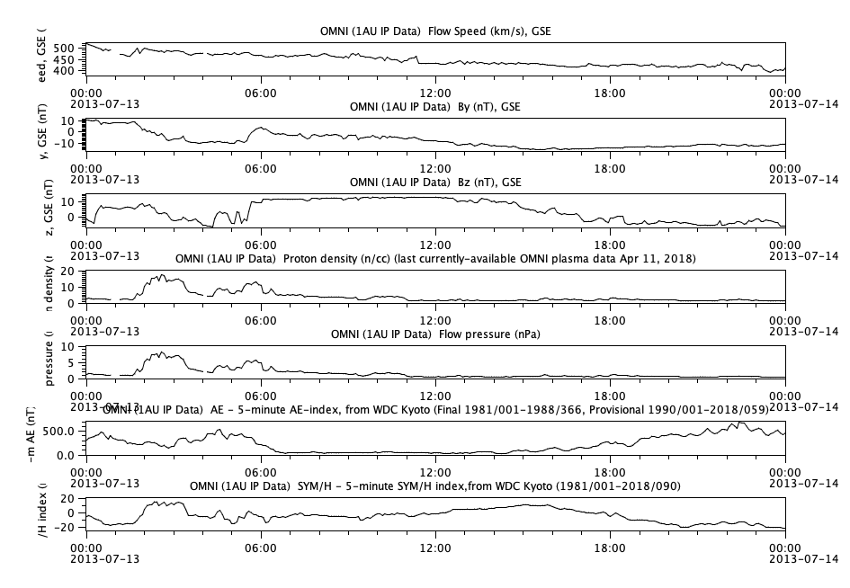

Slide 10
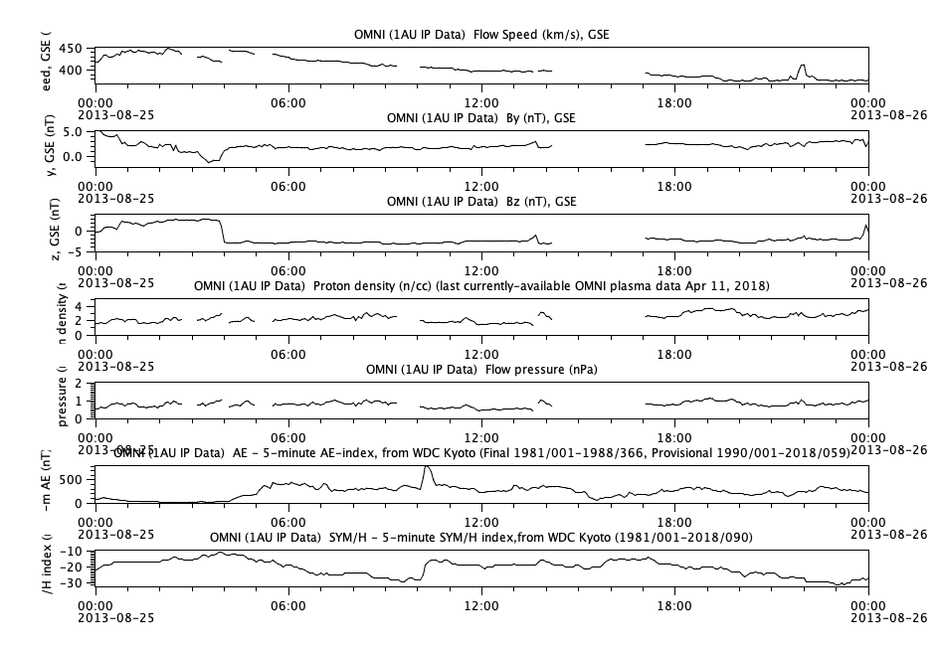

Slide 11
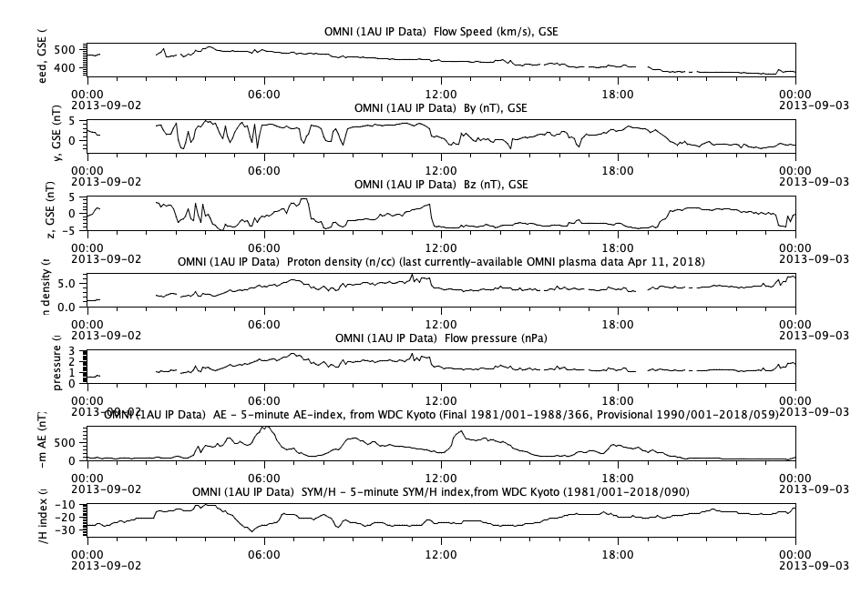

Slide 12
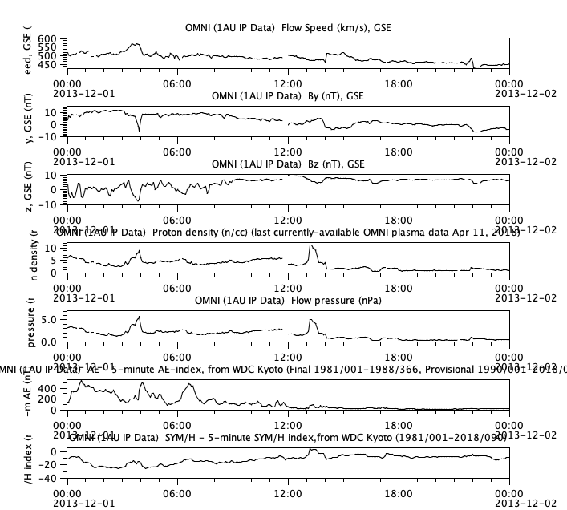

Slide 13
